Slide 1






Purchasing Graduation
PROJECT
Group 2

Slide 2

01
a.
b.
c.
d.
Brief Introduction
Overview
Purpose
Key Features
Business Benefits
02
OVERVIEW
Project Implementation
a.
b.
c.
d.
Purchasing Module Setup
System Configuration
Inventory Setup
Purchasing Configuration
03
Our Team

Slide 3
Brief Introduction
Purchasing Module

Slide 4
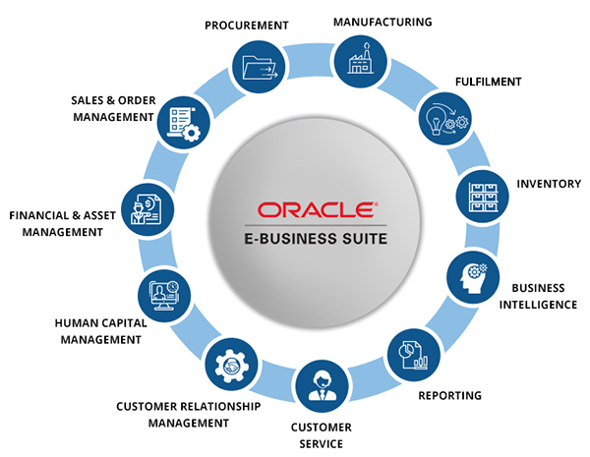




a.
Overview of Oracle E-Business Suite (EBS)
Oracle EBS is an integrated suite of business applications for ERP, SCM, CRM, and more.
Modular architecture (Finance, HR, Procurement, Manufacturing, etc.).
Purchasing Module is part of the Supply Chain Management (SCM) suite.

Slide 5
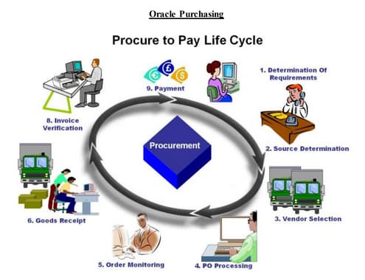
b.
Purpose of the Purchasing Module
Automates procurement processes from requisition to payment.
Centralizes supplier management, purchase orders, and goods receipt.
Ensures compliance with organizational policies and audit controls.

Slide 6

c.
Key Features & Capabilities
Supplier Management: Maintain supplier profiles, contracts, and performance history.
Requisitions & Purchase Orders (POs): Create, approve, and track POs (Standard, Blanket, Contract).
Approval Workflows: Automated routing based on rules (e.g., amount, department).
Receiving & Inspection: Record goods receipt, quality checks, and returns.
Integration: Seamless connection with Inventory, Payables, General Ledger.

Slide 7

d.
Business Benefits
Cost Savings: Negotiate better terms, avoid maverick spending.
Efficiency: Reduce manual paperwork, automate approvals.
Visibility: Real-time tracking of orders, budgets, and supplier performance.
Compliance: Enforce approval hierarchies and audit trails.

Slide 8
Project Implementation
Purchasing Module

Slide 9
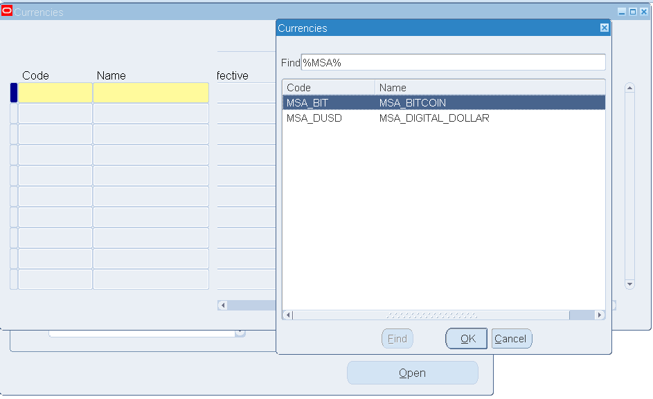
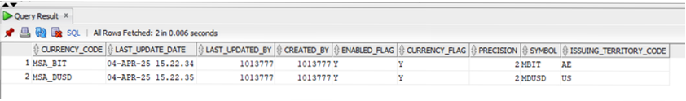
Define Currencies
01
This project will utilize two currencies
a
Digital USD (MSA_DUSD)
b
Bitcoin (MSA_BIT)
03
02
Both currencies were defined in the Virtual machine, but we have redefined both.
03
Required Responsibility: General Ledger super user
04
Path : setup > currencies > define

Slide 10
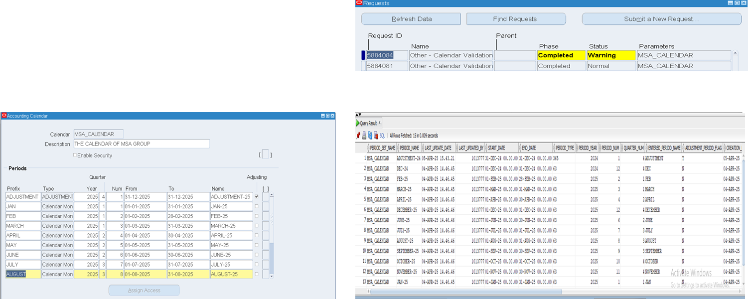
Define New Calendar
Required Responsibility:
General Ledger
Path
setup>Financials>calendars> Accounting

Slide 11
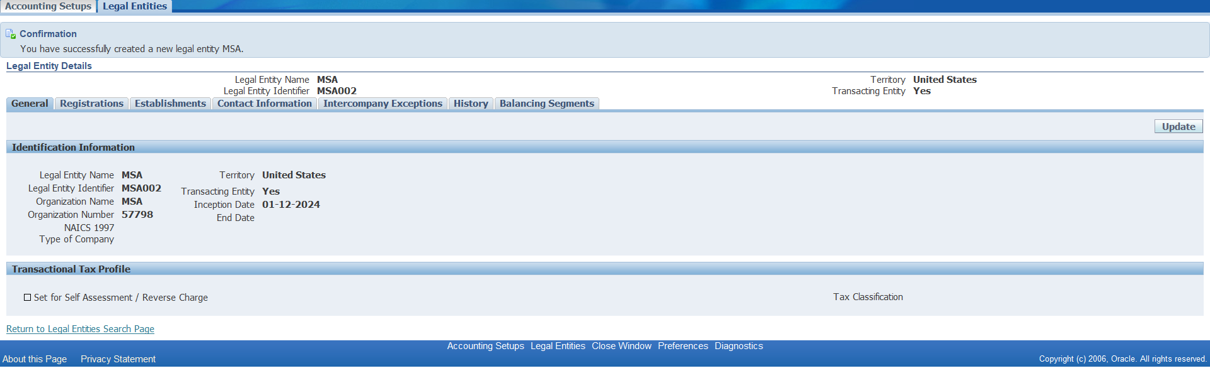
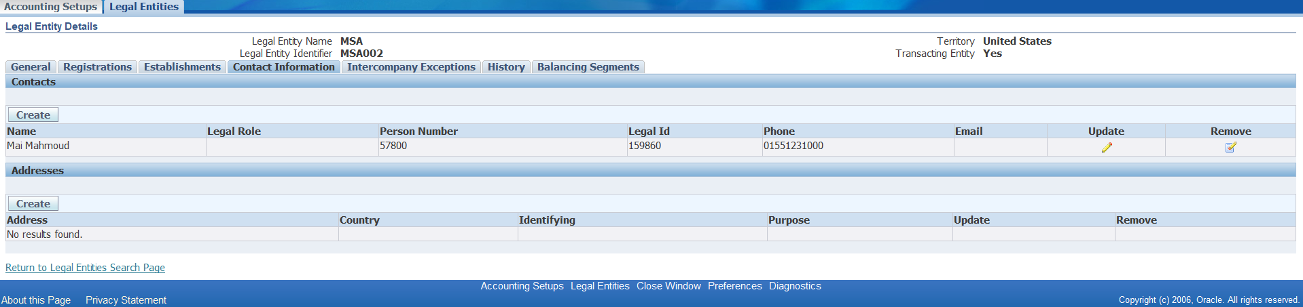
Define Legal Entity
Required Responsibility:
Global Ledger super user
Path
Global Ledger super user> setup > financials>accounting setup Manager> accounting Setups
Provide the required information then save.

Slide 12
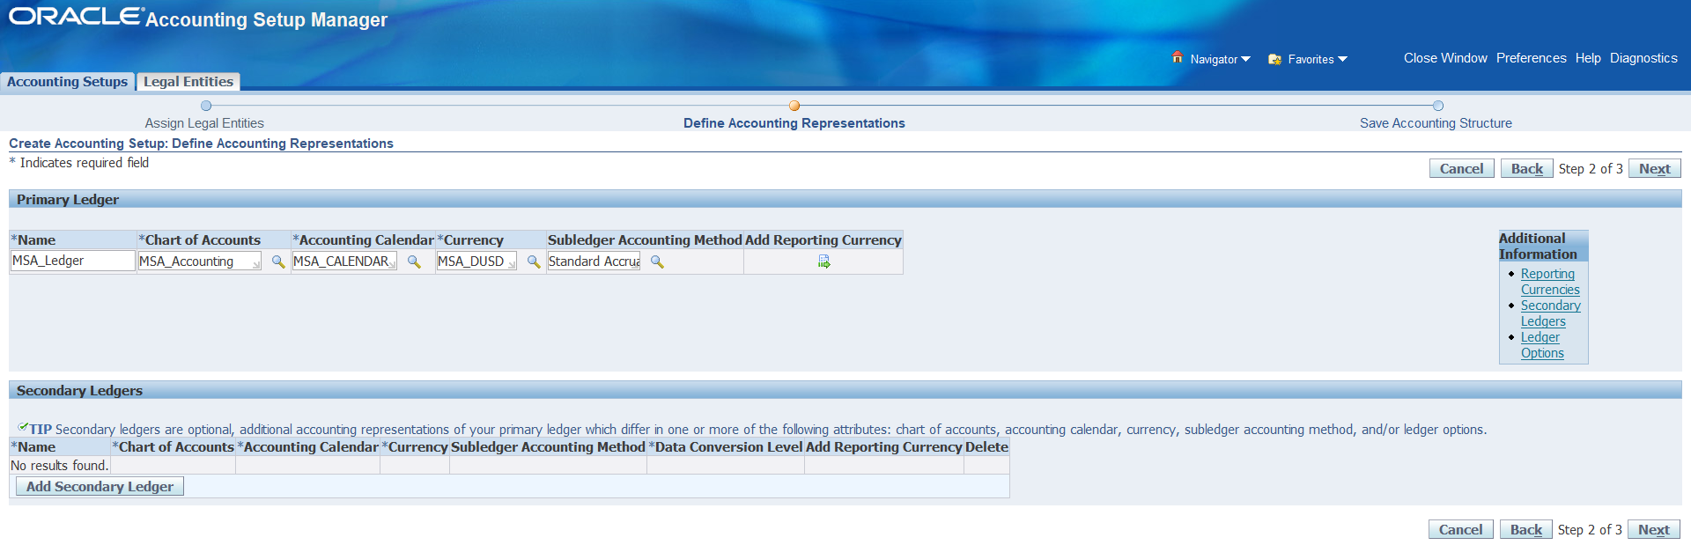
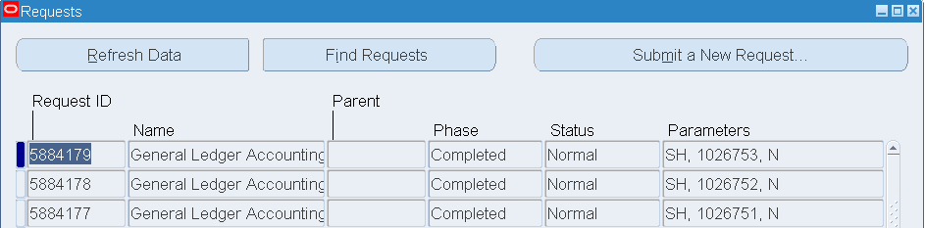
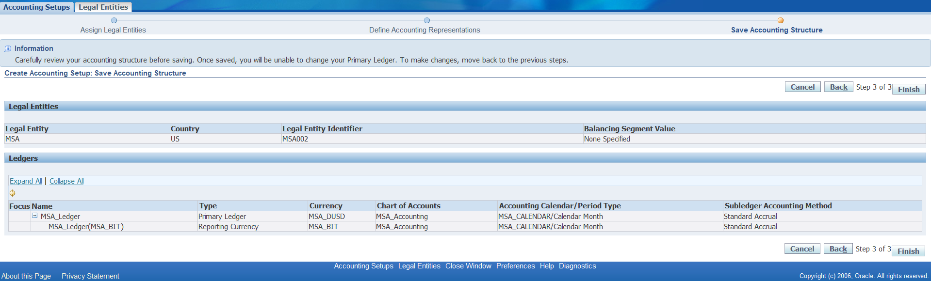
Define Ledger Handling
Required Responsibility:
Global Ledger super user
Path
Global Ledger super user> setup > financials>accounting setup Manager> accounting Setups
Select accounting setup
Choose the defined legal entity (MSA).
Add the defined calendar , currency(MSA_USD) , reporting currency(MSA_BIT).

Slide 13
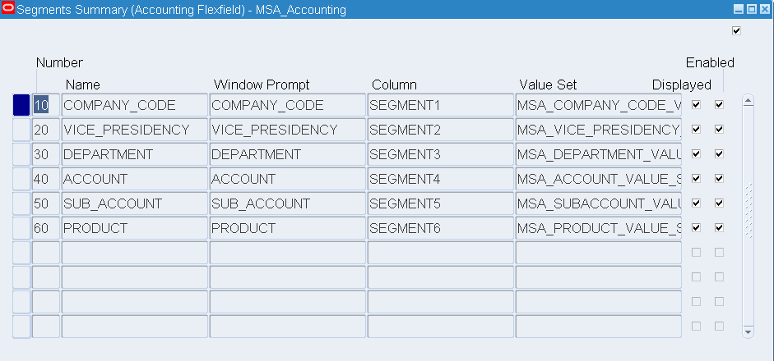
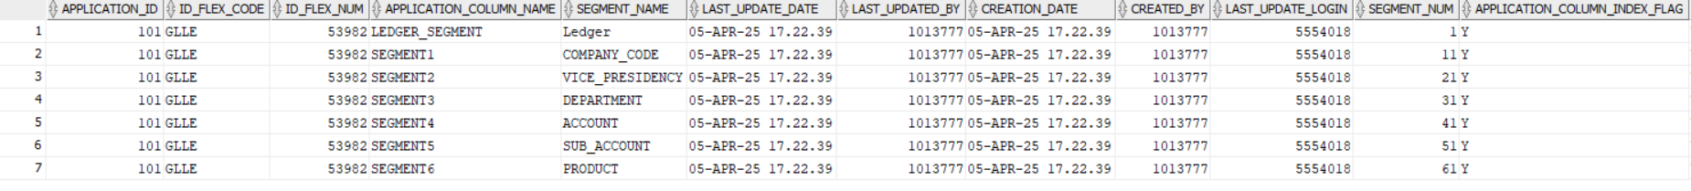
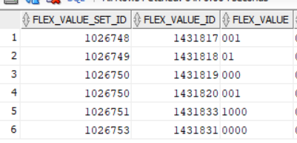
Accounting Flex fields Segments and values

Slide 14
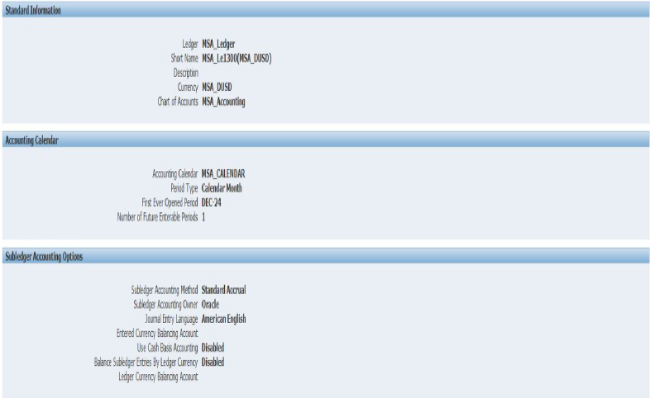
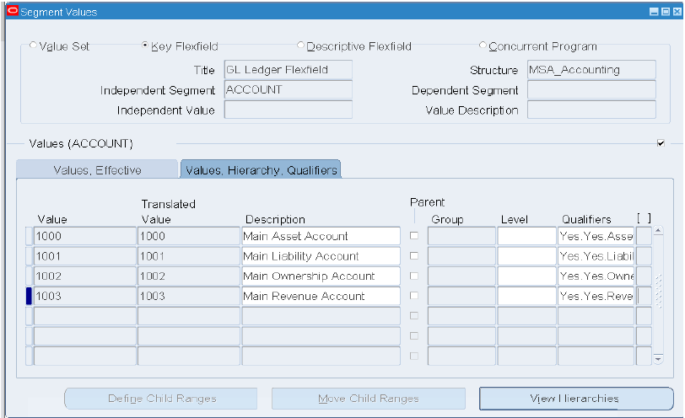
Accounting Flex fields values-2

Slide 15
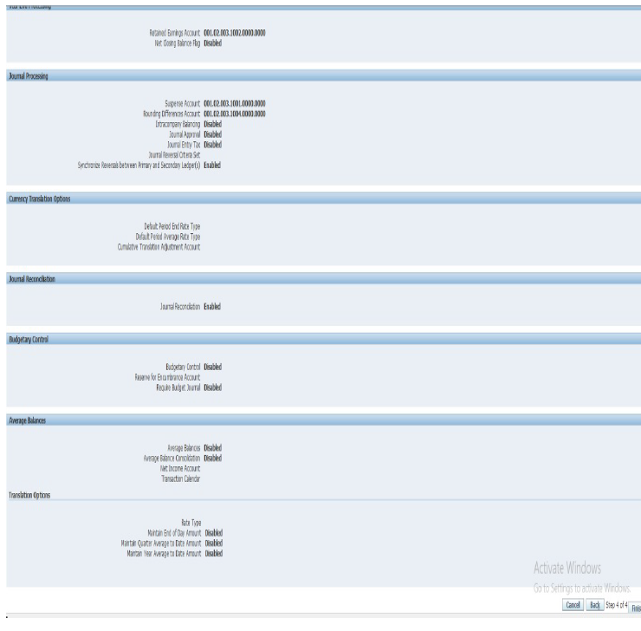
General Ledger Setup Verification

Slide 16
LEDGER RESPONSIBILITY DEFINITION

Slide 17
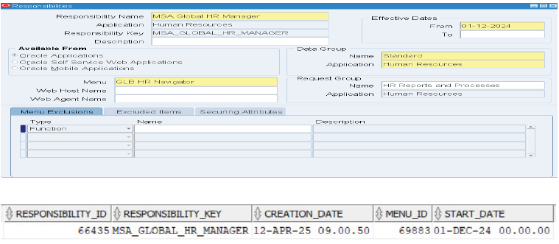
HR Responsibility

Slide 18
INVENTORY RESPONSIBILTY

Slide 19
Creating an operating unit

Slide 20
Create Operating Unit 2

Slide 21
Users Creation

Slide 22
User Creation 2

Slide 23

Setup security profile for responsibilities
The request “Maintain person security list”
The request “Maintain person security list”

Slide 24

System Configuration
Purchasing Module Setup
c. Inventory Setup

Slide 25
Define Workday calendar 1

Slide 26
Define Workday Calendar 2

Slide 27
MASTER ITEM Organization Definition

Slide 28
MSA Inventory Organization Definition

Slide 29
Unit of Measure Classes and Conversions

Slide 30
Item Type Definition

Slide 31
Item Templates

Slide 32
Item Definition

Slide 33

System Configuration
Purchasing Module Setup
d. Purchasing Configuration

Slide 34
Create People in the system

Slide 35
Purchasing Module (Financial Options)

Slide 36
Purchasing Options1

Slide 37
Purchasing Options 2

Slide 38
Create Supplier & Supplier Sites

Slide 39
Supplier Definition 2
Path
Purchasing > Supply Base > suppliers

Slide 40
ITEM Category Configuration

Slide 41
Assign Categories to Items

Slide 42

System Configuration
Purchasing Module Setup
Request for Quotations

Slide 43
Request for Quotations
Request for Quotations : a purchasing document sent to supplier to inquiry about prices and terms of items.
●Catalog RFQ
High Volume
Price breaks
●BID RFQ
High Volume
One time purchase
No price breaks
●Standard RFQ
Price breaks
More flexible

Slide 44
Request For Quotation

Slide 45
09
OUR TEAM
Ahmed Zakaria
Shady
Mohamed Ibrahim
Mai
Shady
Shady

Slide 46


THANK YOU

